Slide 1
2022-2023 PUBLIC HEARING & FINAL BUDGET PRESENTATION
Presented to the
Ridgefield Park Community
May 4, 2022

Slide 2
Important Dates
3/23/2022: BOE Approval of the Preliminary Budget
3/28/2022: Preliminary Budget Due to the County Office
5/4/2022: Public Hearing &Board of Education Approval of 2022-2023 Budget

Slide 3
TAX LEVY ADJUSTMENT
 | ORIGINAL | REVISED
2021-2022 Tax Levy | $27,409,601 | $27,409,601
Adjustments (Health Benefits Savings)* | ($838,957)* | (20,486)*
Subtotal 2021-2022 Levy | $26,570,644 | $27,389,115
2% Increase | $ 531,413 | $ 547,782
2022-2023 Tax Levy After Revised Adjustment | $27,102,057 | $27,936,897*
*Tax levy increased by $834,840 as a result of the revised health benefits savings adjustment

Slide 4
RIDGEFIELD PARK BOARD OF EDUCATION
2022-2023 PROPOSED BUDGET INITIATIVES
Personnel / Staffing
Description | Amount
Salary -Elementary Science Coach - Split to 3 ES bldgs | $ 78,034
Salary -Head Custodian (QSAC) - Grant School | $ 57,613
Salary -Head Custodian (QSAC) - Lincoln School | $ 57,613
Salary -Head Custodian (QSAC) - Roosevelt School | $ 57,613
Salary -Driver F/T | $ 57,613
Salary -Driver F/T | $ 57,613
Salary -HS English Teacher (Reinstating position lost to retirement ) | $ 78,034
Salary -Science Teacher | $ 91,564
Salary -Inclusion Teacher | $ 78,034
Salary -Inclusion Teacher | $ 78,034
Salary -Inclusion Teacher | $ 78,034
Salary -MD Teacher - Grant School | $ 78,034
Salary -MD Teacher Assistant - Grant School | $ 24,931
TOTAL Initiatives: | $ 872,764

Slide 5
CURRICULUM, PROFESSIONAL DEVELOPMENT,
AND PURCHASED SERVICES
Description | Amount
Revised Gr.6-8 Science Textbooks | $ 128,000
ELA Resources: Culturally Responsive Scorecard Rubric | $ 75,000
Flexible Seating, Furn. Replacement | $ 54,139
Health Text Book Series update | $ 22,000
NJSLS standards - HS | $ 25,000
PEEA Feasibility Study for UPK | $ 75,000
Home School Connection, ELA Subscriptions & Math Supplies | $ 43,308
Other Curriculum Supplies | $ 63,500
Home School Connection, ELA Subscriptions & Math Supplies | $ 43,308
Other Curriculum Supplies | $ 89,373
Home School Connection, ELA Subscriptions & Math Supplies | $ 43,308
Other Curriculum Supplies | $ 93,265
TOTAL Initiatives: | $ 755,201

Slide 6
TECHNOLOGY BUDGET INITIATIVES
Loca-tion | Prior-ity |  |  |  | 2020-2021 |  | Total
 |  | Description | Budget Account |  | 2021-2022 | 2022-2023 | Initiatives
TECHNOLOGY Budget Initiatives:
District |  | Cyber Security Assessment/Audit | 11-000-252-330-AL-00-999- |  |  | $ 20,000 | $ 20,000
District |  | Crowd Strike Falcon Complete | 11-000-252-330-AL-00-999- |  |  | $ 85,000 | $ 85,000
District |  | Security Cameras -Additional {Interior/Exterior} | 12-000-262-732-BO-00-999- |  |  | $ 92,000 | $ 92,000
District |  | Transportation: Routing, Cameras, etc. | 12-000-266-732-RP-00-999- |  |  | $ 44,000 | $ 44,000
HS |  | Classroom Audio upgrades | 12-140-100-731-HS-00-050- |  |  | $ 60,000 | $ 60,000
3ES |  | Outdoor Digital Signage | 12-120-100-732-??-00-???- |  |  | $ 30,000 | $ 90,000
District |  | Multi-Factor Authentication | 11-000-266-615-AL-CE-999- |  |  | $ 20,000 | $ 20,000
District |  | Website Hosting with ADA compliance | 11-190-100-610-AL-SO-999- |  |  | $ 15,000 | $ 15,000
District |  | Absence Manager (Frontline Svc) | 11-190-100-610-AL-CU-999- |  |  | $ 18,600 | $ 18,600
 |  | TECHNOLOGY Related Initiatives: |  |  | $ - | $ 384,600 | $ 444,600

Slide 7
FACILITY BUDGET INITIATIVES
Loca-tion | Prior-ity |  |  |  | 2020-2021 |  | Total
 |  | Description | Budget Account |  | 2021-2022 | 2022-2023 | Initiatives
FACILITY Budget Initiatives: |  |  |  |  |  |  | $ -
CST |  | CST Roof Replacement | 12-000-400-450-RP-00-999- |  |  | $ 96,300 | $ 96,300
HS |  | HS Window Replacement Phase III | 12-000-400-450-??-??-999- |  |  | $ 407,250 | $ 407,250
District |  | Arch/Eng Fees for future projects | 12-000-400-390-HS-WW-050 |  |  | $ 80,000 | $ 80,000
District |  | Dodge Cargo Van | 12-000-262-732-BO-00-999- |  | $ 42,000 | $ 23,000 | $ 65,000
District |  | Storage Containers | 12-000-261-732-HS-00-050- |  |  | $ 40,000 | $ 40,000
District |  | Water Bottle Filling Stations | 12-000-261-732-RP-00-999- |  |  | $ 100,000 | $ 100,000
GS |  | Blacktop stencils - GS | 12-000-261-732-GS-00-060- |  |  | $ 20,000 | $ 20,000
RS |  | Blacktop stencils - RS | 12-000-261-732-RS-00-080- |  |  | $ 20,000 | $ 20,000
LS |  | Blacktop stencils - LS | 12-000-261-732-LS-00-070- |  |  | $ 20,000 | $ 20,000
LS |  | Airdale Ventilator Upgrades - (Heat only) | 12-000-400-732-LS-??-070 |  | $ 900,260 | $ - | $ 900,260
HS |  | Science Classroom Upgrades - (#100, #103, #132) | 12-000-400-450-HS-SC-050 |  | $ 929,963 | $ 270,103 | $ 1,200,066
HS |  | Home EC Room Renovations | 12-000-400-450-HS-HE-050 |  | $ 401,750 | $ 459,360 | $ 861,110
HS |  | DOAS Ventilation Unit Replacements* under est. | 20-487-400-732-HS-16-050 |  | $ 832,100 | $ - | $ 832,100
HS |  | Auditorium and Cafeteria Ventilation | 20-487-400-732-HS-19-050 |  | $ 1,171,200 | $ - | $ 1,171,200
HS |  | Bus Loop Parking Upgrade | 12-000-400-xxx-HS-PU-050 |  | $ 282,081 | $ - | $ 282,081
 |  | FACILITY Related Initiatives: |  |  | $ 4,559,354 | $ 1,536,013 | $ 6,095,367

Slide 8
EQUIPMENT AND FURNITURE REQUESTS
Proposed Item | Qty | General Fund Budget | Capital Outlay Fund Budget |  | Budget Account
--- Grant School ---
Student Desks/Tables | 100 | 25,000.00 |  |  | 11-190-100-610-GS-FR-060-
Student Chairs | 125 | 6,250.00 |  |  | 11-190-100-610-GS-FR-060-
Misc. Furniture (book cases, storage, etc.) | 1 | 10,500.00 |  |  | 11-190-100-610-GS-FR-060-
Flexible Seating (additional) | 1 | 6,482.25 |  |  | 11-190-100-610-GS-FR-060-
Classroom Area Rugs |  | 4,500.00 |  |  | 11-190-100-610-GS-RG-060-
--- Lincoln School ---
Student Desks/Tables | 110 | 24,750.00 |  |  | 11-190-100-610-LS-FR-070-
Student Chairs | 170 | 7,650.00 |  |  | 11-190-100-610-LS-FR-070-
Misc. Furniture (book cases, storage, etc.) |  | 5,400.00 |  |  | 11-190-100-610-LS-FR-070-
Flexible Seating (additional) |  | 11,482.25 |  |  | 11-190-100-610-LS-FR-070-
Classroom Area Rugs |  | 6,000.00 |  |  | 11-190-100-610-LS- mix
--- Roosevelt School ---
Flexible Seating (additional) |  | 7,482.25 |  |  | 11-190-100-610-RS-FR-080-
--- High School ---
Student Desks/Tables/Chairs | 300 | 18,000.00 |  |  | 11-190-100-610-HS-FR-050-
Misc. Furniture |  | 3,000.00 |  |  | 11-190-100-610-HS-FR-050-
Flexible Seating (additional) |  | 6,482.25 |  |  | 11-190-100-610-HS-FR-050-
 |  | $ 142,979.00 | $ - |  | Not duplicated in CSA Doc.
TOTAL Proposed Equipment & Furniture >>> |  |  | $ 142,979.00

Slide 9
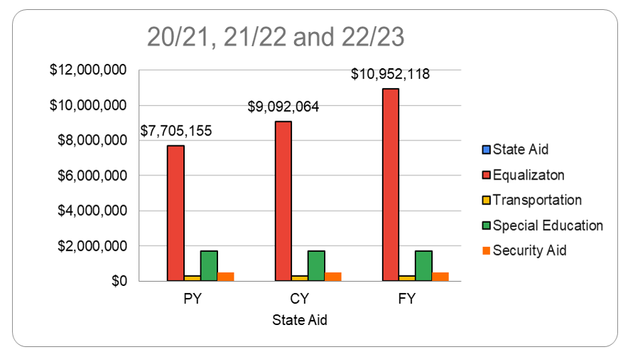
BREAKOUT OF INCREASED STATE AID
Notes:
Tax Levy Cut - Approximately $300,000

Slide 10
TAX IMPACT
How Does The Proposed School Budget Impact Your Current Expense Tax Rate?
Tax Rate for the General Fund is 1.745%
The Average Home Assessment Value: $366,365
Total General Fund Taxes – Average Assessed Home: $6,393.07
Increase Over Prior Year: $178.14 ($14.85/month)

Slide 11
REVENUE
LOCAL TAX LEVY | $ 27,936,897
STATE AID | $ 13,701,318
TUITION Little Ferry Reg Ed/Reg Ed Shared ES Special Ed: Bogota, Little Ferry, Maywood | $ 5,202,479
WITHDRAWAL FROM CAPITAL RESERVE | $ 503,550
TRANSPORTATION Dumont, Teaneck, Little Ferry | $ 357,809
MISCELLANEOUS REVENUE GovDeals, E-Rate, Refunds/Adjustments Shared Bus Coordinator & Guidance Counselor with Little Ferry | $ 179,512
SEMI/MEDICAID | $ 64,561
INTEREST INCOME | $ 14,350
GENERAL OPERATING BUDGET | $ 47,960,476

Slide 12
SPECIAL REVENUE FUND - BUDGETED AT 85%
Safety Grant
Nonpublic Textbooks
Nonpublic Compensatory Education
Nonpublic Supplementary Education
Nonpublic Speech/Nursing/Technology/Security
Nonpublic English as a Second Language
Title I
Title II A
Title III
Title IV A
IDEA Basic
IDEA Preschool
Total Projected Special Revenue Fund | $ 1,104,163
Total Revenue 2022-2023 | $ 49,064,639

Slide 13
EXPENDITURES
General Current Expense | $ 45,889,622
Capital Outlay | $ 1,865,438
Summer Programs | $ 157,987
Transfer To Charter School | $ 47,429
Total General Operating Budget | $ 47,960,476
Special Revenue Fund | $ 1,104,163
Total Expenditures | $ 49,064,639

Slide 14
HIGHLIGHTS
State Aid increased by $1,860,054 over State Aid awarded in 2021-2022
Tax levy increased by $834,840 as a result of the revised health benefits savings adjustment
Increase in Tax Levy resulted in the following changes to the final proposed budget
Construction:
$459,360 allocated to a commercial kitchen at the Jr./Sr. High School
$270,103 allocated to new science labs at the Jr./Sr. High School
Increase in Home Economics for Groceries due to inflation: $5,377
Increase in state loan payment by $100,000*

Slide 15
2022-2023 PUBLIC HEARING & FINAL BUDGET PRESENTATION
Questions?

